Slide 1

Gamespace
VCW Software
Carter Ellis, Shangqing Wei (Will), Viano Arcery

Slide 2
What We Have Done
HTML, CSS, JavaScript (basics)
Login Screen
Home Page
Profile Page
Friends Page
Settings Modal
Database Configuration
Self-signed SSL Cert
Apache Configuration
Notes:
Games are about shared experiences. All successful games have communities made up of their large groups of gamers. However, because of the diversity of games and a variety of gaming platforms, communities of gamers are numerous but never unified. For a heavy gamer, they may need to spend a lot of time logging on and browsing different websites to get information about various games. In addition, for users on Steam, they only show their game list and achievements on Steam. Their friends won't know if they're playing games from platforms like Blizzard or Epic. Also, there may be a lot of haters online for other similar games, because they only discuss in their own game community and never learn about other good games. So, we propose Gamespace to deal with these problems in the gaming community. We want to bring together users from all platforms and provide them a peaceful and free platform to discuss games. We can help players save a lot of trouble in finding communities, and let them find more friends easily on our platform.

Slide 3
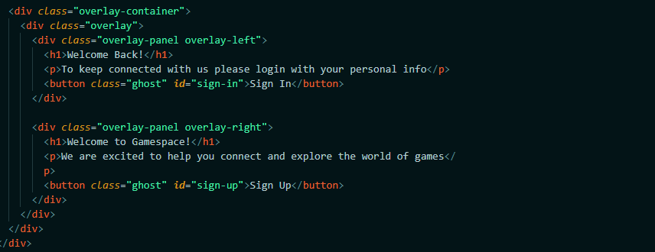
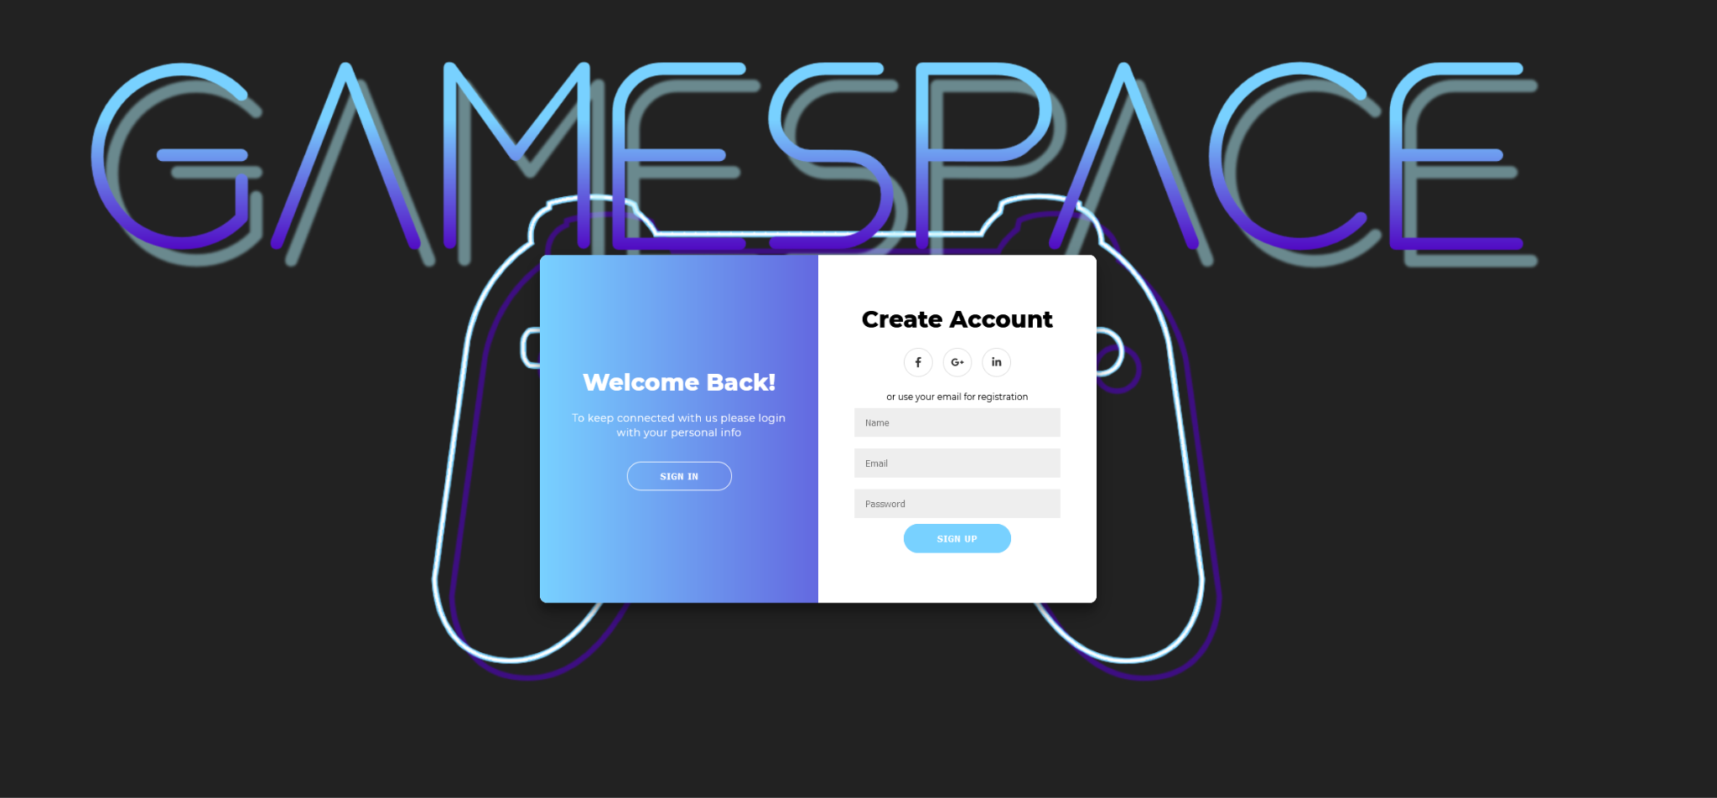
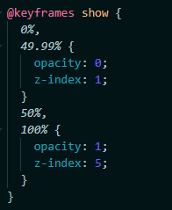
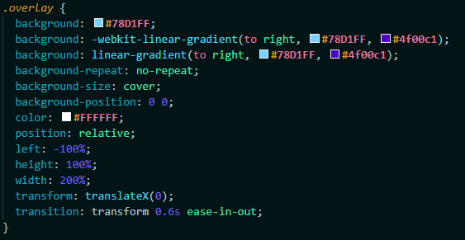
Login

Slide 4
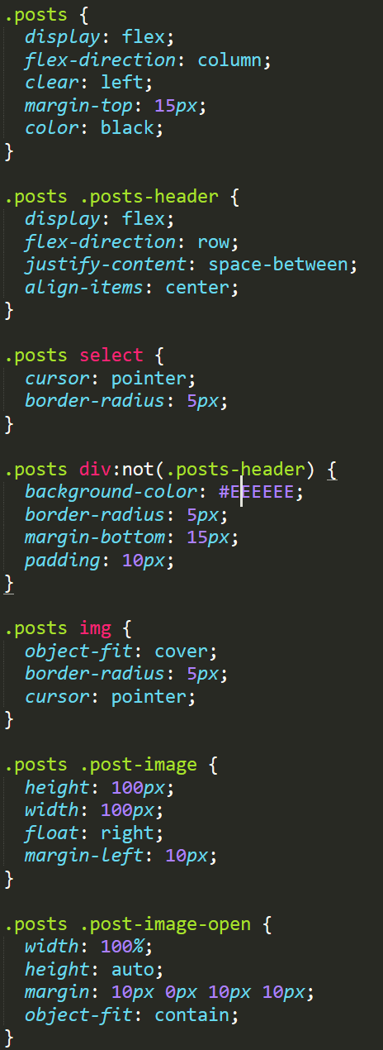
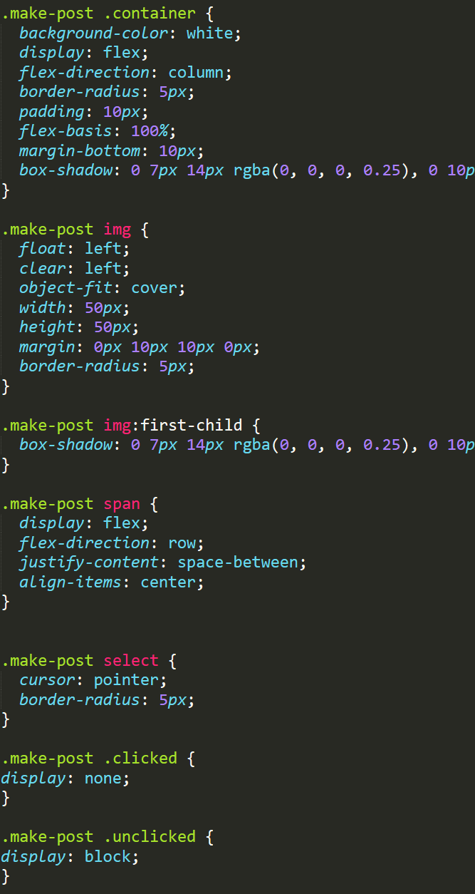
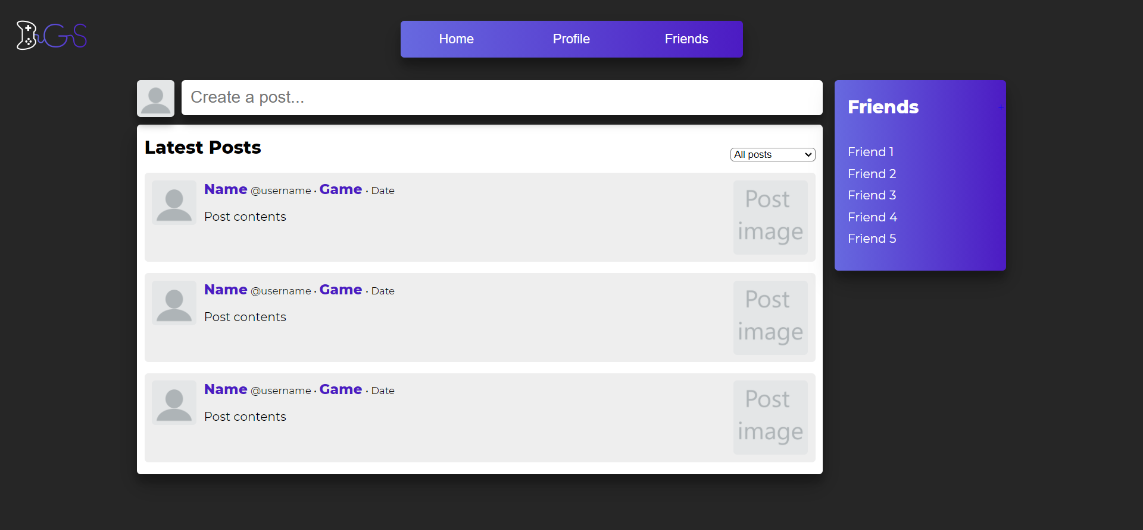
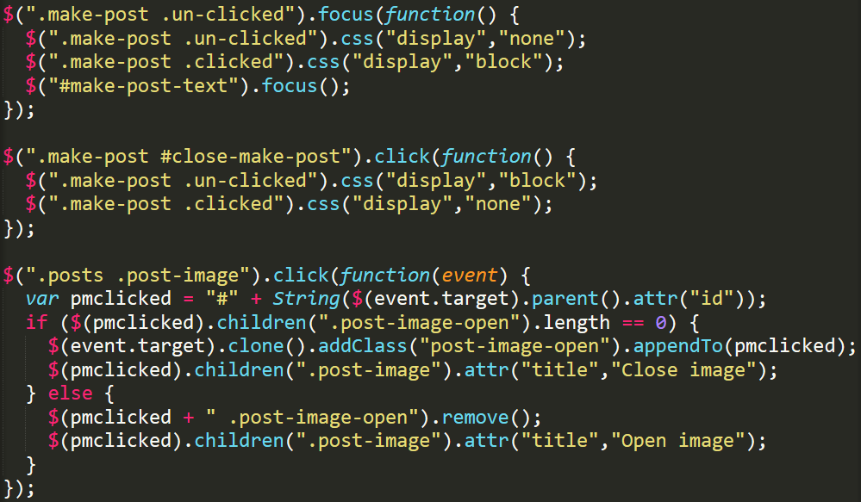
Home Page

Slide 5
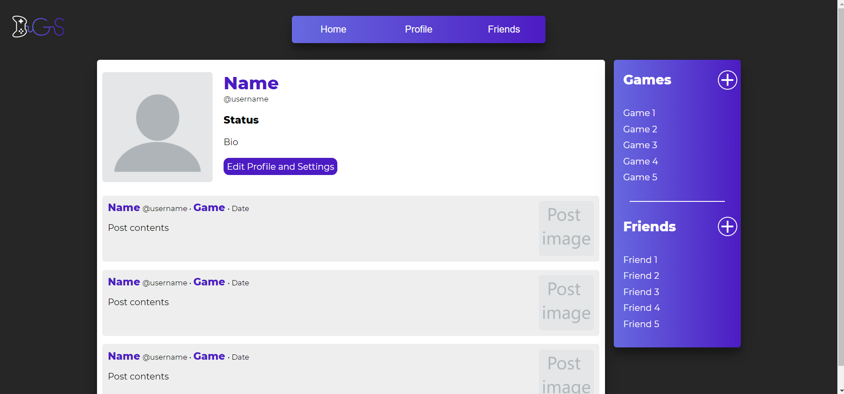
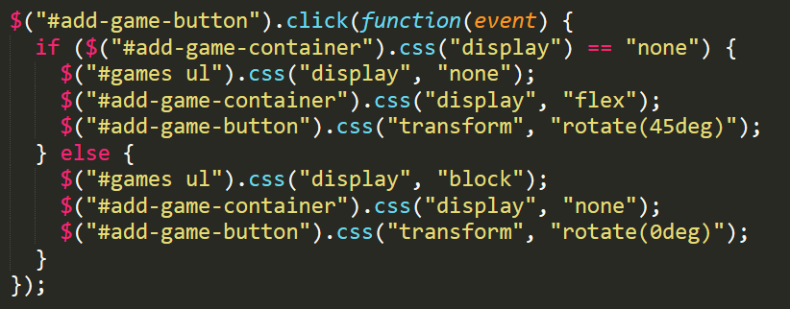
Profile Page

Slide 6
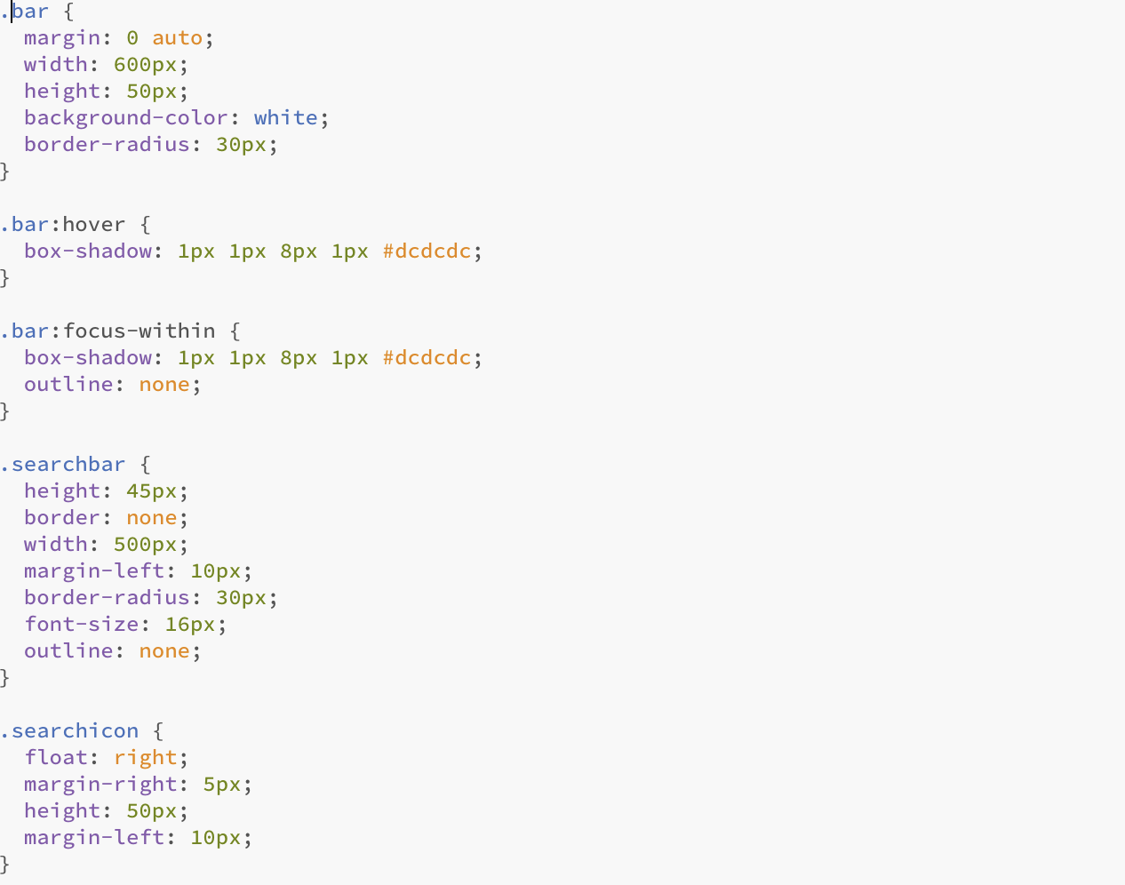
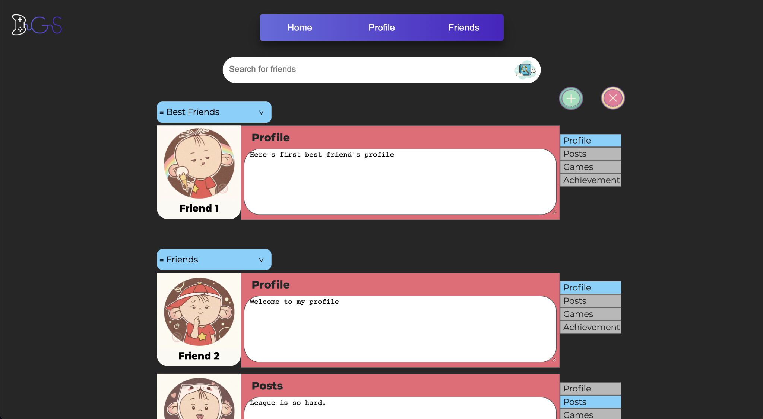
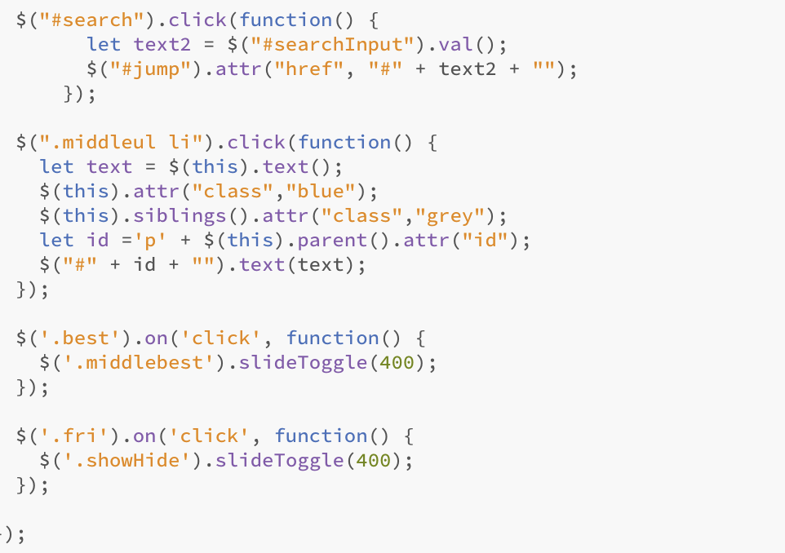
Friends Page

Slide 7
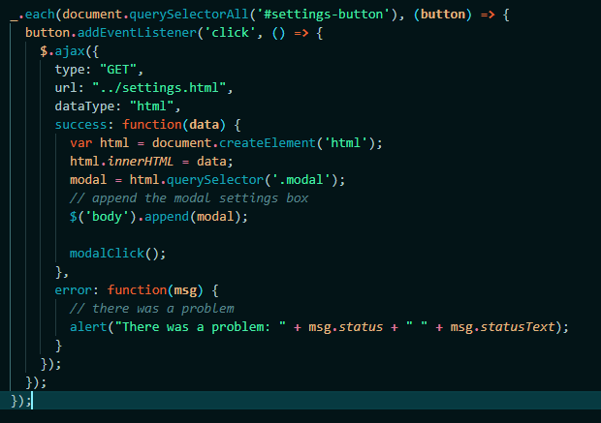
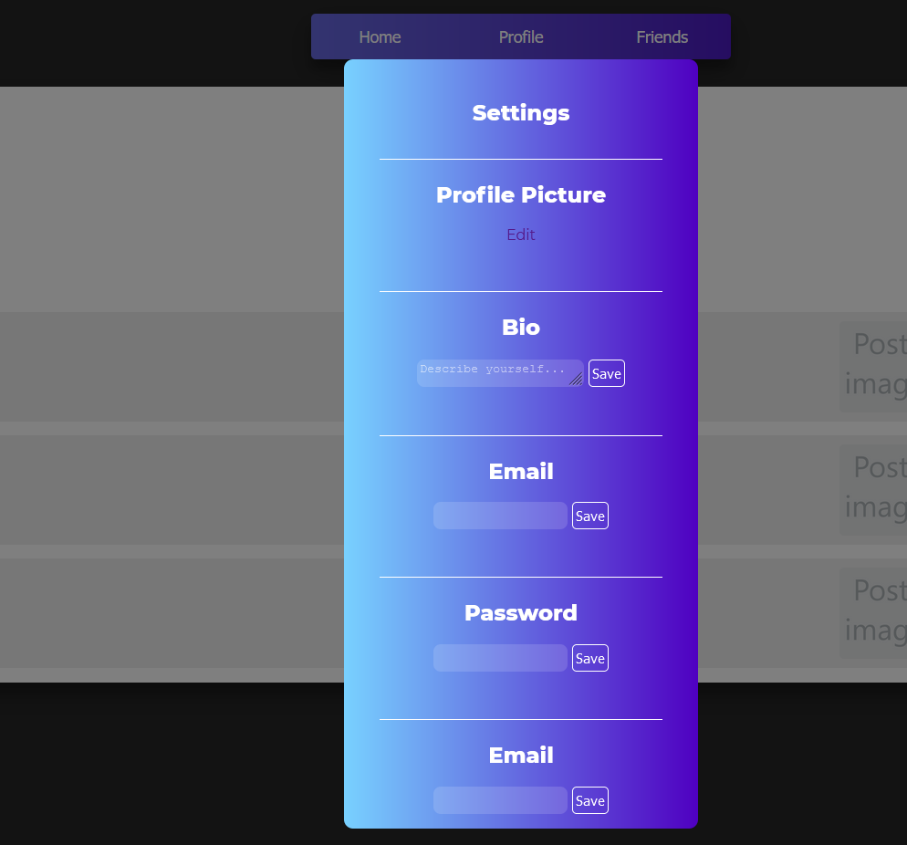
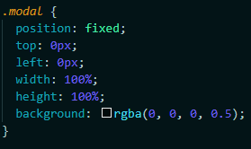
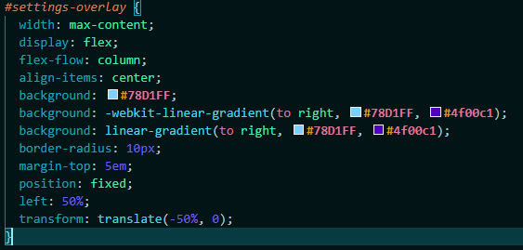
Settings Modal Box

Slide 8

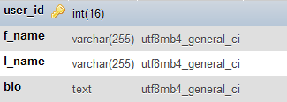
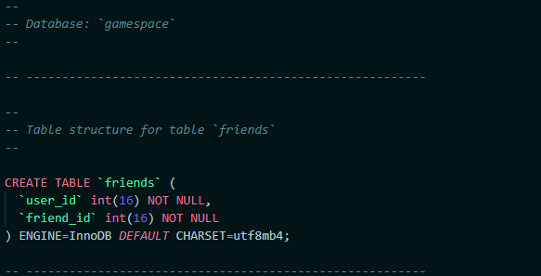
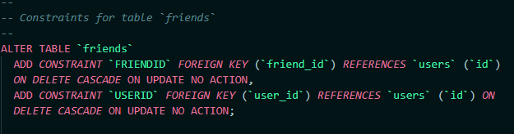
Database Config
Users Table (login credentials and uid)
Foriegn Key Constraints

Slide 9
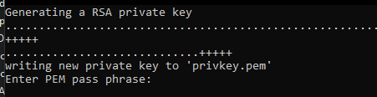
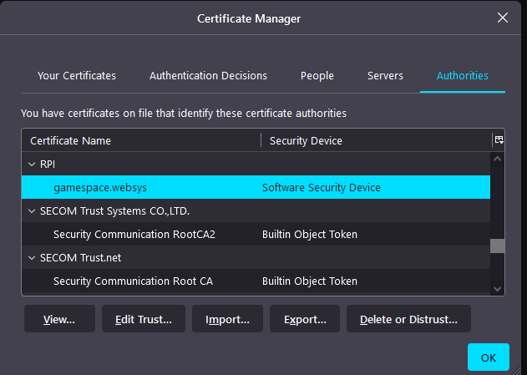
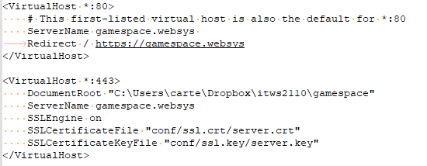
SSL and Apache
C:\xampp/apache/makecert.bat
C:\xampp\apache\conf\ssl.crt

